Slide 1

PROJECT 4 MEMBERS: KATHERINE CONLON FRANCIS SULKOWSKI LAUREN MATOS MAY HLI YANG

Slide 2

PROJECT PROPOSAL
Field Data: Healthcare
Intent: Leveraging machine learning to optimize Ozempic recommendations

Slide 3
QUESTIONS:
What is Ozempic?
What health issues are incorporated with the use and prescription of Ozempic?
What are the intents of Ozempic?
What are the qualifying features for Ozempic?
Is Ozempic in high demand? By who?

Slide 4
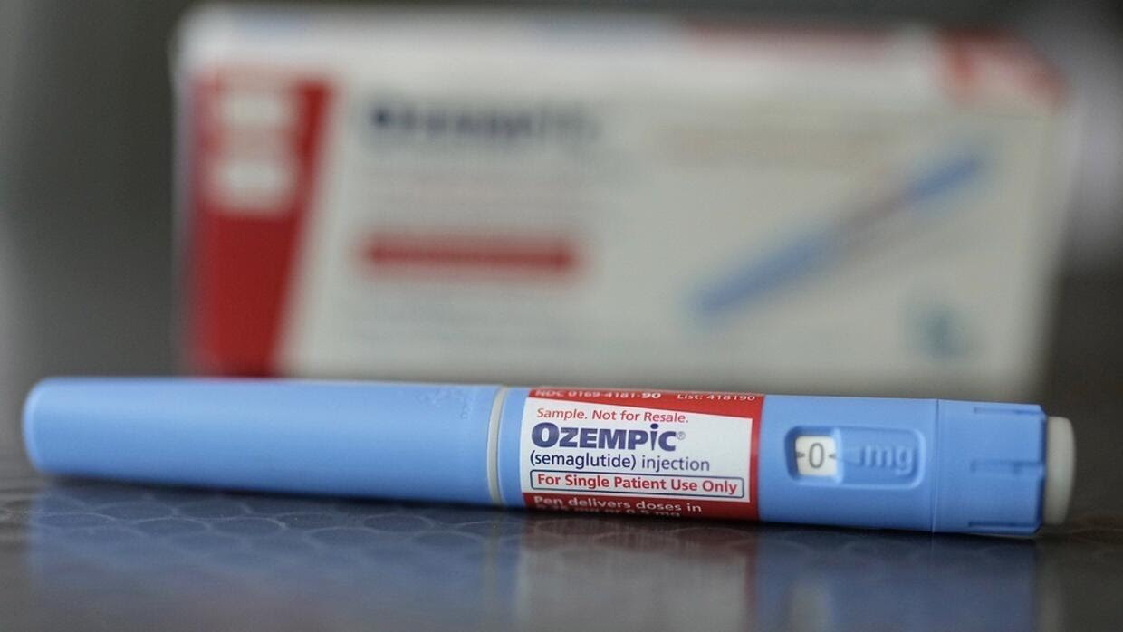
IN THIS PROJECT:
Built a classification model to predict Ozempic qualification based on factors like BMI, blood pressure, cholesterol, smoking, alcohol use, and physical activity.
Created advanced features, including risk score and comorbidity flag, to optimize model accuracy.
Improved dataset balance with SMOTE and optimized RandomForest model using GridSearchCV.
Model predicts patients who qualify for Ozempic, identifying high-risk individuals in need of the drug.
GLP-1 Assessment Tool: Built a web app using Flask to predict Ozempic eligibility based on user inputs like BMI and age, incorporating logic to assess eligibility criteria and display results dynamically.
This Photo by Unknown Author is licensed under CC BY-SA

Slide 5

WHAT IS OZEMPIC?
An injectable prescription medicine used: along with diet and exercise to improve blood sugar (glucose) in adults with type 2 diabetes to reduce the risk of major cardiovascular events such as heart attack, stroke, or death in adults with type 2 diabetes with known heart diseases.

Slide 6
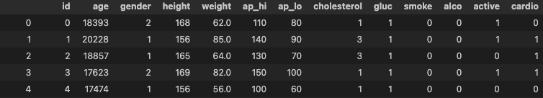
DATA
Kaggle Dataset: From Kaggle, this cardiovascular disease dataset includes key health metrics like blood pressure, cholesterol, and lifestyle factors, ideal for training models to predict Ozempic qualifications.
Key Health Metrics: The dataset features critical health indicators like age, blood pressure, cholesterol, glucose levels, and physical activity, directly influencing Ozempic qualification.
Comorbidity Focus: Tracks lifestyle factors (smoking, alcohol use) and existing conditions like cardiovascular disease, which are essential for evaluating metabolic risks and determining eligibility for Ozempic.

Slide 7
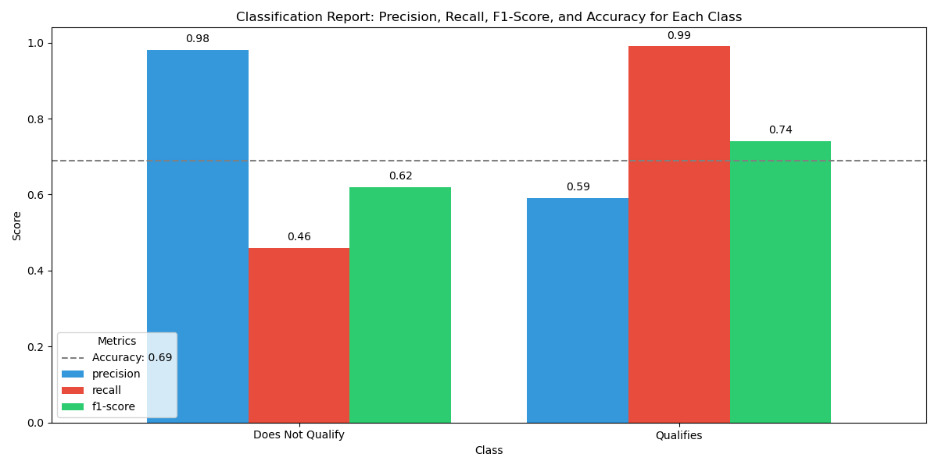
CLASSIFICATION REPORT 1 - PRE-OPTIMIZATION
Pre-Optimization: Our group trained a RandomForest model to predict if individuals qualify for Ozempic using basic demographic and health features. The chart shows two groups: Qualifies and Does Not Qualify.
Model Performance: The initial model achieved 69% accuracy, with the Does Not Qualify group having a higher precision but lower recall, while the Qualifies group had the opposite. The model needed more advanced feature engineering to enhance prediction accuracy.
Next Steps: To optimize the model, we introduced more advanced feature engineering techniques to improve the model's performance.

Slide 8
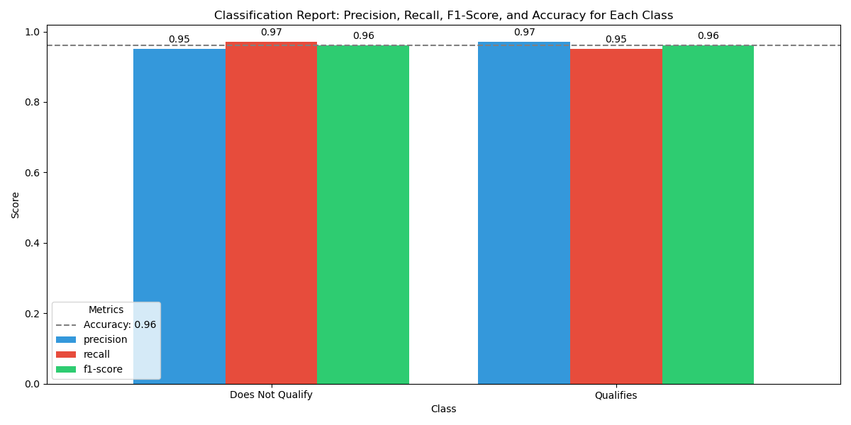
CLASSIFICATION REPORT II - OPTIMIZED MODEL
Model Optimization: We enhanced the RandomForest model by adding advanced features like BMI categories, blood pressure range, risk score, comorbidity flag, and interaction features (cholesterol-glucose, smoke-alco).
Model Performance: The optimized model achieved 96% accuracy, with high precision and recall for both classes.
Evaluation Results: Precision, recall, and f1-score for both classes were excellent, around 0.96.
Next Steps: The optimized model was saved as a .pkl file for future use.
Notes:
The chart compares the model’s performance for two groups: “Does Not Qualify” and “Qualifies,” using Precision, Recall, and F1-Score. Precision is 100% for “Does Not Qualify” and 96% for “Qualifies.” Recall is 95% for “Does Not Qualify” and 100% for “Qualifies.” The F1-Score is 97% for “Does Not Qualify” and 98% for “Qualifies.” The overall accuracy is 98%, as indicated by a dashed gray line. Each bar shows its value for clarity.

Slide 9
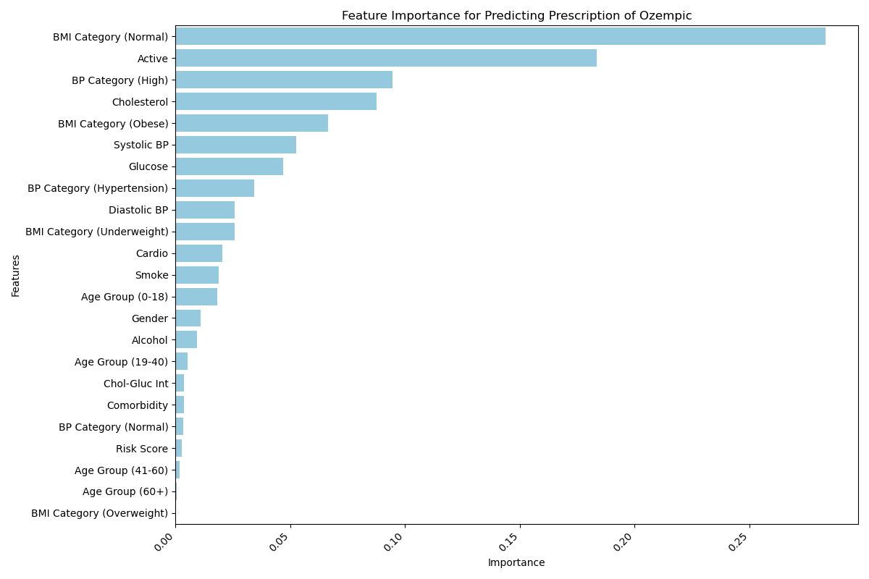
IMPORTANCE OF PREDICTING PRESCRIPTION OF OZEMPIC
The chart ranks feature importance for predicting Ozempic qualification using a RandomForest model.
Top features: BMI Category - Normal, Activity Level, and High Blood Pressure are most important, with BMI Normal being key due to its potential to disqualify individuals from eligibility.
Important features: Cholesterol, BMI Category (Obese), Systolic BP, and Glucose are significant.
Additional insights: BP Category (Hypertension), Diastolic BP, and BMI Category (Underweight) have lower impact, with Cardiovascular Problems, Smoke, and other health features being less influential.
Notes:
This chart visualizes the importance of various features in predicting whether someone should be prescribed Ozempic. The features include categories like gender, blood pressure (BP), cholesterol, glucose levels, smoking, alcohol consumption, activity level, BMI categories, age groups, comorbidity, and other health-related indicators. The bar chart ranks these features by their importance in the model, with the most influential ones appearing at the top. Features with higher importance contribute more significantly to the model’s predictions. The x-axis shows the importance values, while the y-axis lists the corresponding features, with labels rotated for better readability.

Slide 10
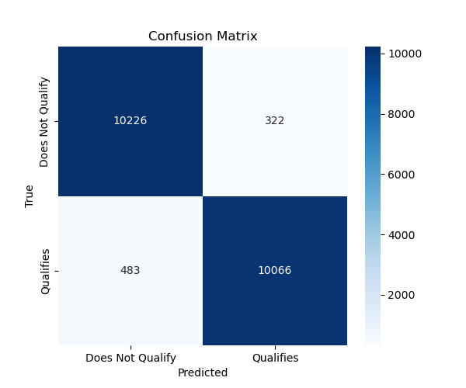
Confusion matrix visualizes model performance with true vs. predicted outcomes.
X-axis shows predicted outcomes: Does Not Qualify, Qualifies.
Y-axis shows actual outcomes: Does Not Qualify, Qualifies.
Values inside the matrix indicate correct/incorrect predictions (true positives, false positives, etc.).
Annotations display the count of predictions in each category.
Model performance: 10,226 true negatives, 10,066 true positives, 322 false positives, 483 false negatives.
Notes:
This chart displays the confusion matrix for predicting Ozempic prescriptions, which helps evaluate the model’s performance by comparing the predicted classifications to the actual outcomes. The matrix is visualized as a heatmap, where the x-axis represents the predicted outcomes (either “Does Not Qualify” or “Qualifies”) and the y-axis represents the actual outcomes. The values inside the matrix show the number of correct and incorrect predictions. The annotations within the heatmap indicate the count of predictions, with darker shades of blue representing higher values. This chart helps assess how well the model differentiates between the two classes.

Slide 11
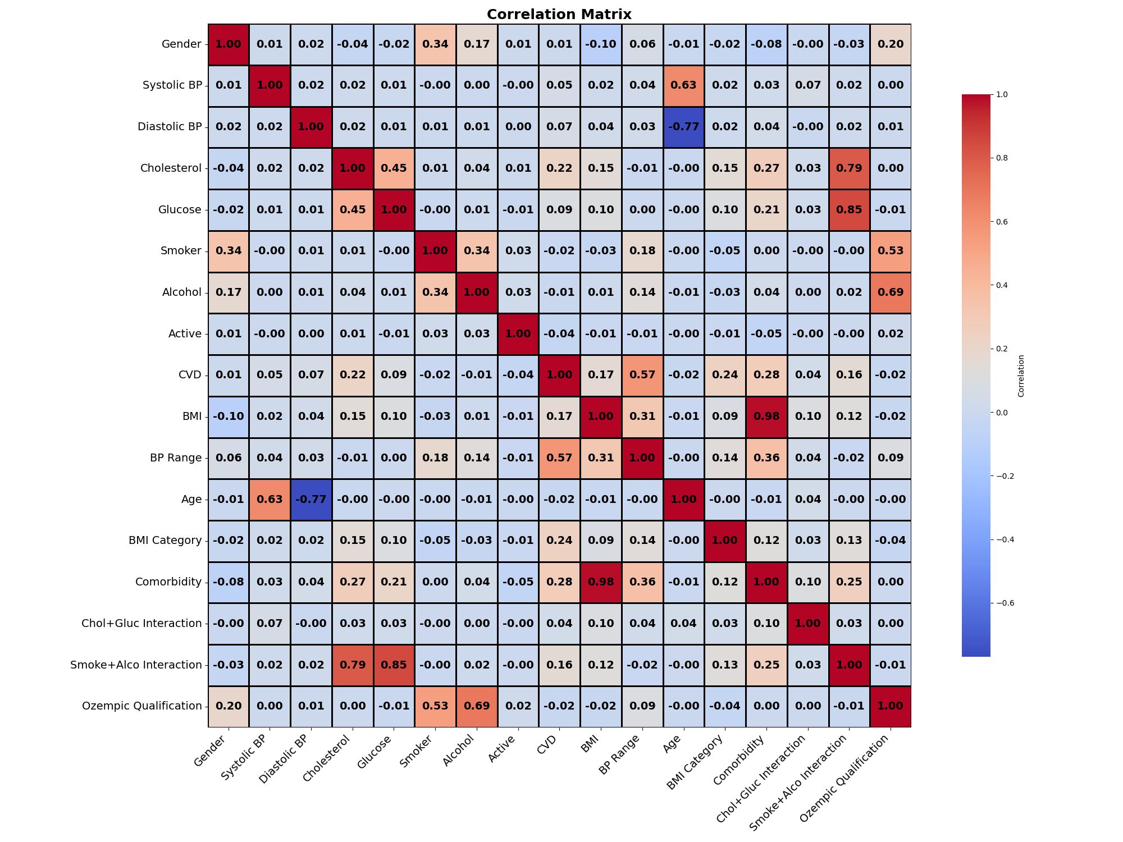
Correlation matrix heatmap represents the relationships between various features in the dataset
Depicts how strongly different variables are correlated with one another
Each cell indicates correlation coefficient between 2 features
Blue = strong negative correlation
Red = strong positive correlation
White = no correlation
Notes:
This chart is a correlation matrix heatmap that visually represents the relationships between various features in the dataset. It shows how strongly different variables are correlated with each other, with each cell in the heatmap indicating the correlation coefficient between two features. The color scale (from cool to warm) helps highlight the strength of these correlations, with blue indicating a strong negative correlation, red showing a strong positive correlation, and white representing no correlation. The annotations inside the cells provide the exact correlation values, making it easier to interpret. This heatmap is useful for identifying which factors might be strongly related to each other, which could help in feature selection and understanding relationships in the data.

Slide 12
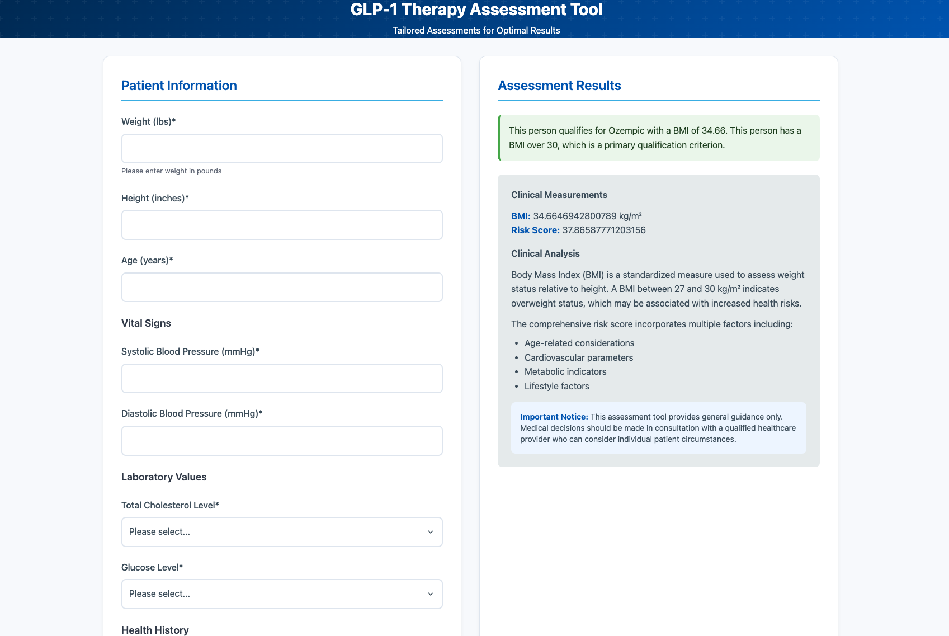
Integrating Machine Learning into a Flask Web Application
Model Loading & Input: The Flask app loads a pre-trained machine learning model from a optimized_model.pkl file and collects health data (e.g., weight, age, blood pressure) from users.
Data Processing & Prediction: The app calculates BMI, risk scores, and other features, then uses the model to predict eligibility for Ozempic.
Results Display: Qualification results, including BMI and risk score, are displayed dynamically on the webpage.
Design: The form is designed with Tailwind CSS for a responsive and user-friendly layout.

Slide 13
SOURCES:
https://www.ozempic.com/ ↩
https://www.keckmedicine.org/blog/ozempic-for-weight-loss-los-angeles/ ↩ ↩2
https://www.yahoo.com/lifestyle/ozempics-biggest-night-how-weight-loss-drugs-showed-up-at-the2025-golden-globes-055552886.html ↩
https://www.americannamesociety.org/ozempic-is-the-ans-name-of-the-year-for-2024/ ↩
https://www.cnbc.com/2024/04/03/weight-loss-diabetes-drug-ad-spending-tops-1-billion.html ↩
https://doi.org/10.55016/ojs/muj.v2i2.79247 ↩

